Slide 1


AI-Powered Road Damage Detection - Potholes & Cracks (India)

Slide 2

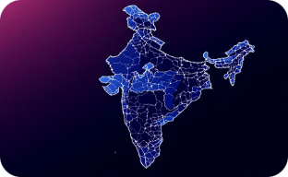

The Problem - Safety, Scale, Cost
Rising Road Risk
Massive Asset Base
Low-Cost Sensing Opportunity
53% rise in pothole-related accidents (MoRTH 2020–24). Immediate danger to road users and increasing liability for authorities.
India: ~5.5M km of roads, manual inspection is slow and costly (≈ ₹500 crore/year).
Smartphone dashcams enable scalable data capture. AI detection can convert footage into civic action and prioritized repairs.

Slide 3

Scope - What we cover (concise)
In Scope
Out of Scope
Potholes (D40 threshold)
Smartphone dashcam captures
RDD2022 India images
Non-Indian datasets for final model
Minor cracks
Large structural failures requiring civil survey
Multi-modal sensors (LIDAR)

Slide 4


Dataset - RDD2022 India
Dataset snapshot: 7,000+ India-specific images covering local roads and highways. Samples include smartphone captures across weather (monsoon), lighting, shadows and motion blur intentionally representative of deployment conditions.
Dataset prepared for fine-tuning and evaluation with India-centric edge cases (occlusion, small potholes, parked vehicles).

Slide 5

Critical Gaps Identified
Domain Bias
Edge Speed Constraints
Models trained on non-Indian data lose 15–25% mAP when applied to Indian road textures and contexts.
Many models deliver <10 FPS on typical CPUs - insufficient for live civic monitoring.
Lack of India Fine-tuning
Small/Obscured Defects
RDD2022 India remains underutilized for targeted fine-tuning and validation.
Small potholes and damage under blur/occlusion are frequently missed, impacting recall.

Slide 6

Our Contribution - Technical Summary
Performance
Efficiency
India fine-tuning → +15% mAP (relative), measured on RDD2022 India holdout.
Model distillation and pruning → sustained 15+ FPS on mid-range CPU (i5-class), target >12 FPS on typical smartphone SoC.
Contextual Deployment
Robustness
System tuned for smartphone civic monitoring and municipal reporting pipelines.
Cross-region validation to ensure generalization

Slide 7
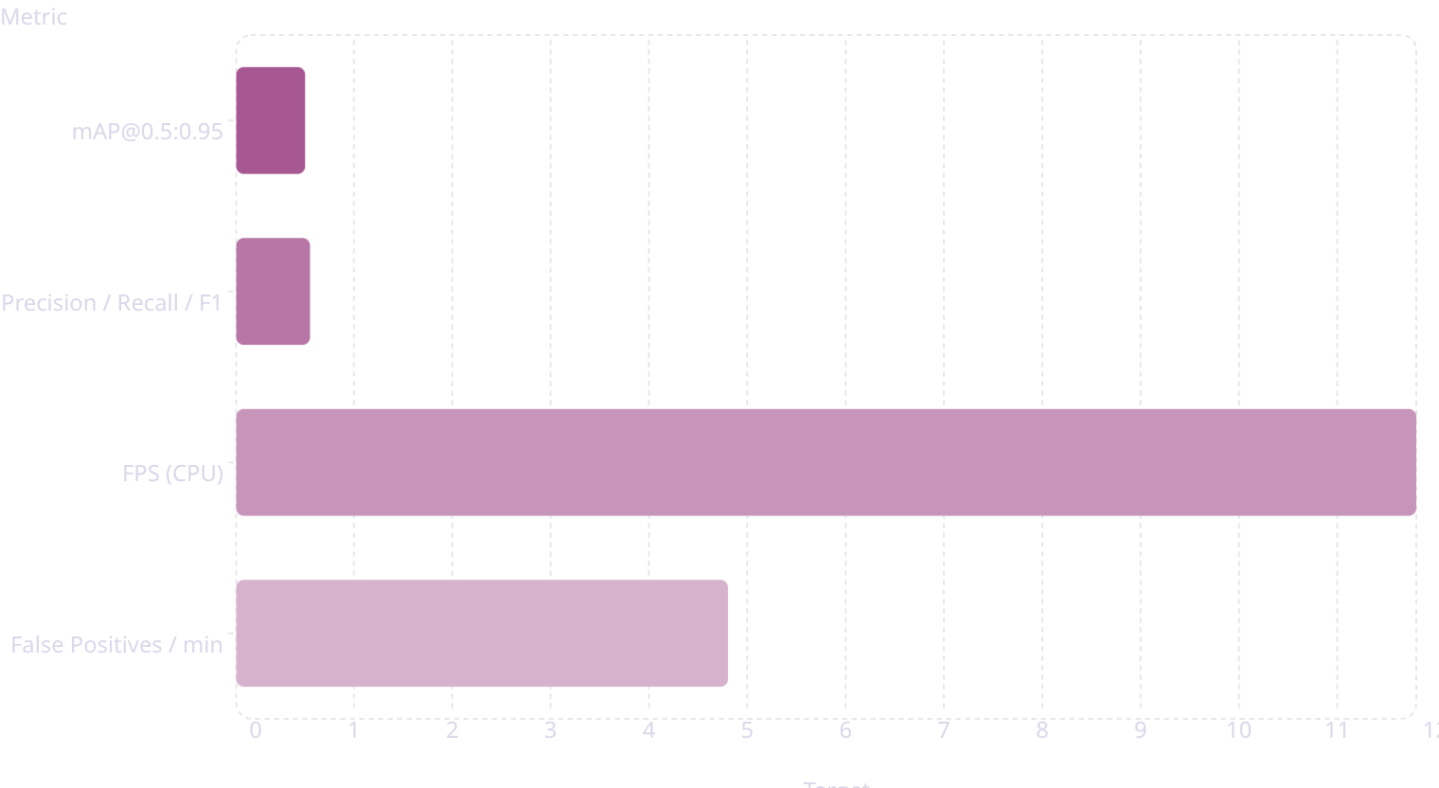
Success Metrics - Clear, Measurable Targets
Primary metric:
mAP across IoU range 0.5 (target >0.70).
Precision, Recall, F1 ≥ 0.75.
Real-time inference >12 FPS on standard CPU

Slide 8



Evidence & Evaluation Plan
Quantitative
Qualitative
Benchmarking
Baseline vs Ours:
Detection videos across varied conditions (monsoon, night, occlusion) to validate real-world usability for civic teams.
Real FPS measurements on i5-class CPU and representative smartphone SoCs
mAP
Precision
Recall
FPS

